Slide 1
GraSPI
Graph-based Structure-Property Identifier
Last updated on November 2020

Slide 2
Motivation: at molecular level a large pool of descriptors/features exists
Dragon molecular descriptor list: 51 pages with 4885 descriptors
Do we need so many?
Data automation lowers energy barriers
Can we find the smallest set of features
Feature engineering and data analytics enables the reduction
Challenge: lack of large pool of descriptors @ microstructure level
Notes:
Dragon is used to
evaluate molecular structure-property relationships,
similarity analysis
high-throughput screening of molecule databases.

Slide 3
GraSPI aims to fill the gap
GraSPI annotates microstructure with the set of descriptors/features.
Given a segmented micrograph (black and white image), the set of descriptors is calculated.
The set of descriptors captures size, shape and topological characteristics of the morphology.
The set of descriptors has been motivated by the application for organic solar cells but can be generalized for other applications
To enable the generalization, we plan to group the descriptors into mathematical descriptors and physics-encoded descriptors.

Slide 4
What problem GraSPI solves?
As of now, given the segmented image, compute set of descriptors (scalars, histograms) and physics-weighted descriptors (scalars and histograms)
In the future, expand the set of descriptors to include more descriptors, expand the representation to include the skeletons (topological features), expand the physics-based weighting functions, add representation-specific distance measures (beyond the Euclidean distance) and couple it with dimensionality reduction techniques.

Slide 5
We propose a two-level representation
Level 1: voxel-based representation
Level 2: topology preserving representation
Microstructure
Graph
Microstructure
Distance map
Medial axis
Graph
Steps involved:
For each voxel in the microstructure image create vertex in graph
Connect vertices in the graph following neighborhood of the image (first and second order neighbors)
Steps involved:
calculate distance field to the interface
Remove voxel based on the distance field to get medial axis
Covert the medial axis into graph representation
GraSPI: Graph-based Structure descriptor Interrogator

Slide 6
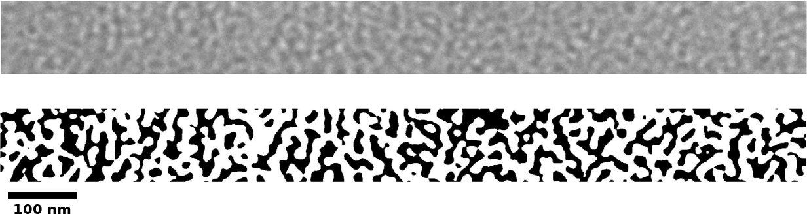
From micrograph to set of statistics and descriptors
Micrograph
Set of descriptors
/features

Slide 7
Graph-based representation is flexible to define and compute wide range of descriptors
Filter graph
Query filtered graph
Using standard graph-based algorithms
connected component algorithm
Shortest path
Microstructure
Graph={V,E}
Steps involved:
For each voxel in the microstructure image create vertex in graph
Connect vertices in the graph following neighborhood of the image (first and second order neighbors)
Filter graph and query the graph

Slide 8
Graph-based representation is flexible to define and compute math- and physics-based descriptors
Compute all distances
from black pixels to the interface (green meta vertex)
Compute histograms
Add the weighting function
that capture some aspect of the physics
Represent microstructure as a graph and add meta vertices
Filter graph
Make graph query:
Find shortest paths from
green vertex to all black vertices
Simple post processing Make queries to extract more specific descriptors
This physics—based descriptor is meaningful and serves as a surrogate for PDE-based model.
It captures non-local effects.

Slide 9
How it works
Represent morphology as graph
Add meta vertices to facilitate the computations of the descriptor (top/bottom surface, interface)
Learn how to filter the graph to facilitate graph queries for various features
Execute basic algorithms: e.g., compute connected components, compute the shortest paths

Slide 10
Descriptor=graph filtering (meta vertices)+graph algorithms
Filter graph

Slide 11
How to use it?
C++: command line program (input morphology using one of two formats: array or graph format)
Python: cythonized graspi (input morphology as numpy array)

Slide 12
Inputs, useful scripts, example, outputs

Slide 13
Input: two accepted formats
4 4 1
1 1 0 0
0 1 1 0
0 1 1 0
0 0 1 0
Array:
nx ny nz
[array of labels: size nx*ny*nz ]
We use a row-wise order to store the matrix of pixels/vertices.
Graph:
nVertices
[indexOfVertex labelOfVertex (triplet: indexOnNeighbor weight/distance orderOfNeigbor ) ] nVertices Lines
16
0 1 4 1 f 5 1.42 s 1 1 f -1 1 f
1 1 5 1 f 6 1.42 s 2 1 f -1 1 f 0 1 f 4 1.42 s
2 0 6 1 f 7 1.42 s 3 1 f -1 1 f 1 1 f 5 1.42 s
...
14 1 -2 1 f 15 1 f 11 1.42 s 10 1 f 9 1.42 s 13 1 f
15 0 -2 1 f 11 1 f 10 1.42 s 14 1 f
16 0 0 s 1 0 s 2 0 s 3 0 s
17 15 0 s 14 0 s 13 0 s 12 0 s
This is a custom format of adjacency list that additionally encodes information about the weights and order of the edge

Slide 14
Example of usage
Go to folder folder examples/2phaseMorphologies/thinFilm Input: set of morphologies in the array format
Execute script RunTests.sh Outcome: set of descriptors in log file and set of files with distances
Execute script PrepareReport.sh
Outcome: pdf with the report.
Source: see folder examples/2phaseMorphologies/thinFilm

Slide 15
Output
GraSPI outputs the descriptors to the standard output that can be redirected to another stream (e.g., log files). It also determines several sets of shortest distances. The corresponding distances/path lengths are saved following files
DistancesGreenToRedViaBlack.txt
DistancesGreenToBlueViaWhite.txt
DistancesBlackToRed.txt
DistancesWhiteToBlue.txt
DistancesBlackToGreen.txt
TortuosityBlackToRed.txt
TortuosityWhiteToBlue.txt
The names of the file indicates the conditions used to filter the graph. For example file DistancesBlackToGreen.txt stores all the shortest distances between any donor/black/0 voxel and the interface/green.

Slide 16
Useful scripts
GraSPI has been set up to execute the high throughput analysis.
In the folder examples, two scripts have been included: RunTests.sh and PrepareReport.sh (both in bash – the command language)
RunTests.sh shows how to execute GraSPI for all input files
PrepareReport.sh shows how to generate histograms and aggregate descriptors with histogram into one report. [Dependencies: latex, gnuplot]

Slide 17
Computational complexity
GraSPI computes the set of descriptors at
the low cost:
2D examples – order of seconds
3D examples – order of minutes
Note linear complexity of the execution time
The largest problem solved on the desktop machine (35M) under 3 minutes
N- number of vertices
E- number of edges
Technical details: Coded in C/C++ using boost graph library

Slide 18
Computational complexity: comparison between c++ and python
Note a small overhead due to the cythonization

Slide 19
Resources
See our paper for the definition of descriptors used
https://arxiv.org/abs/1106.3536v2
How to cite this package:
Wodo, Olga, Srikanta Tirthapura, Sumit Chaudhary, and Baskar Ganapathysubramanian. "A graph-based formulation for computational characterization of bulk heterojunction morphology." Organic Electronics 13, no. 6 (2012): 1105-1113

